Slide 1
AI for Hardware
Wearable Sleep Detection
Xi Chen, Haoran Zhang

Slide 2

Project Description: The goal of this project is to build a wearable device that incorporates TinyML to detect if someone is sleeping. Key Objectives: - Deliver the device that's comfortable to wear - A communication system allowing wireless communication - Embed TinyML to predict the states Technology Stack: - Seeed XIAO nRF52840 sense - EasyEDA PCB Design - Python, C++ - Bambu 3D Printer

Slide 3
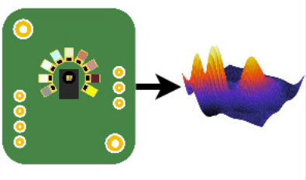
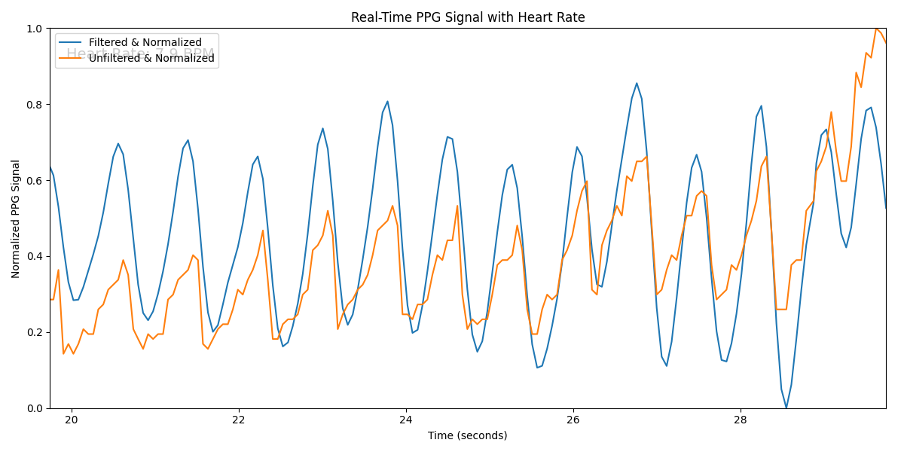
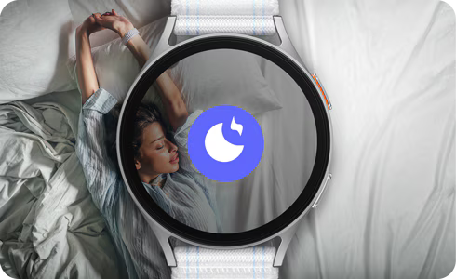
1. Study Methodology
Training on powerful computer
PPG signal collecting
Signal processing with bandpass filter
Near-infrared Channel: To collect PPG signal
590nm, 630nm, 680nm: To calibrate ambient light change for robust PPG signal
Bandpass filter with cutoff 0.3-2.5Hz to filter out human PPG signal
Deploy checkpoints back by TinyML

Slide 4
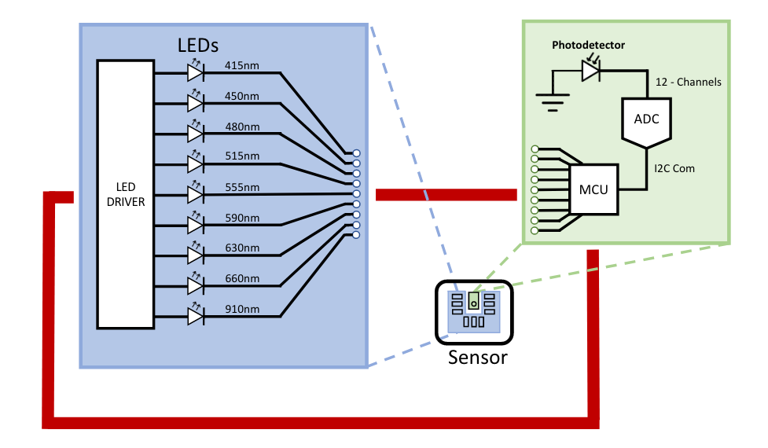
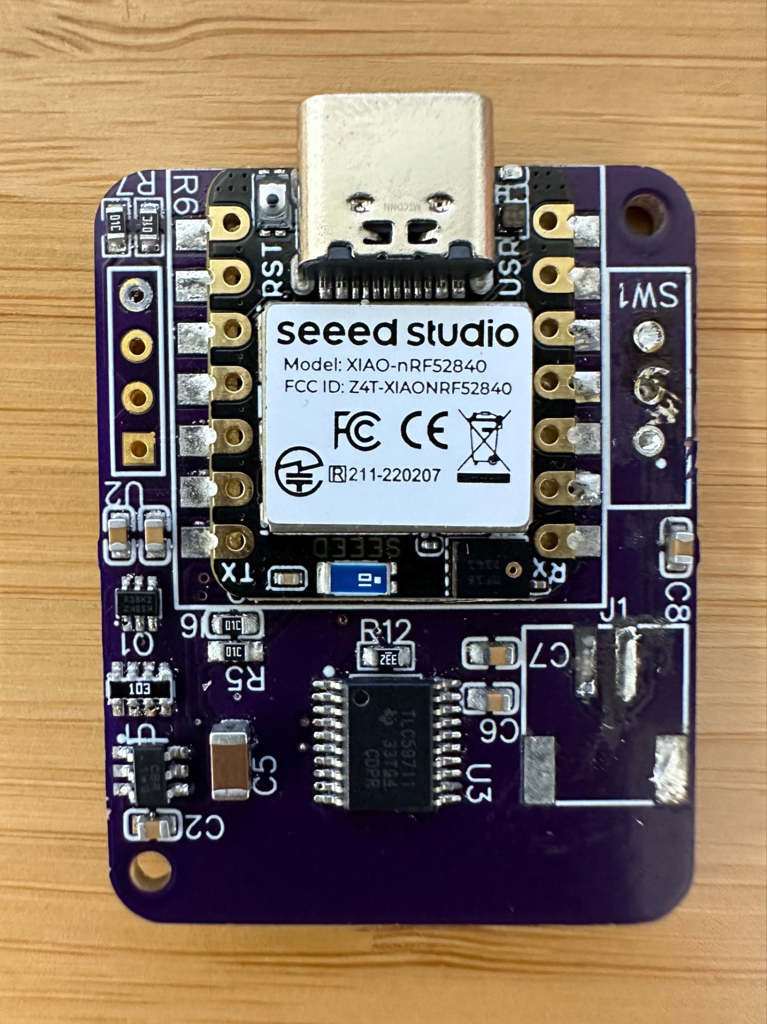
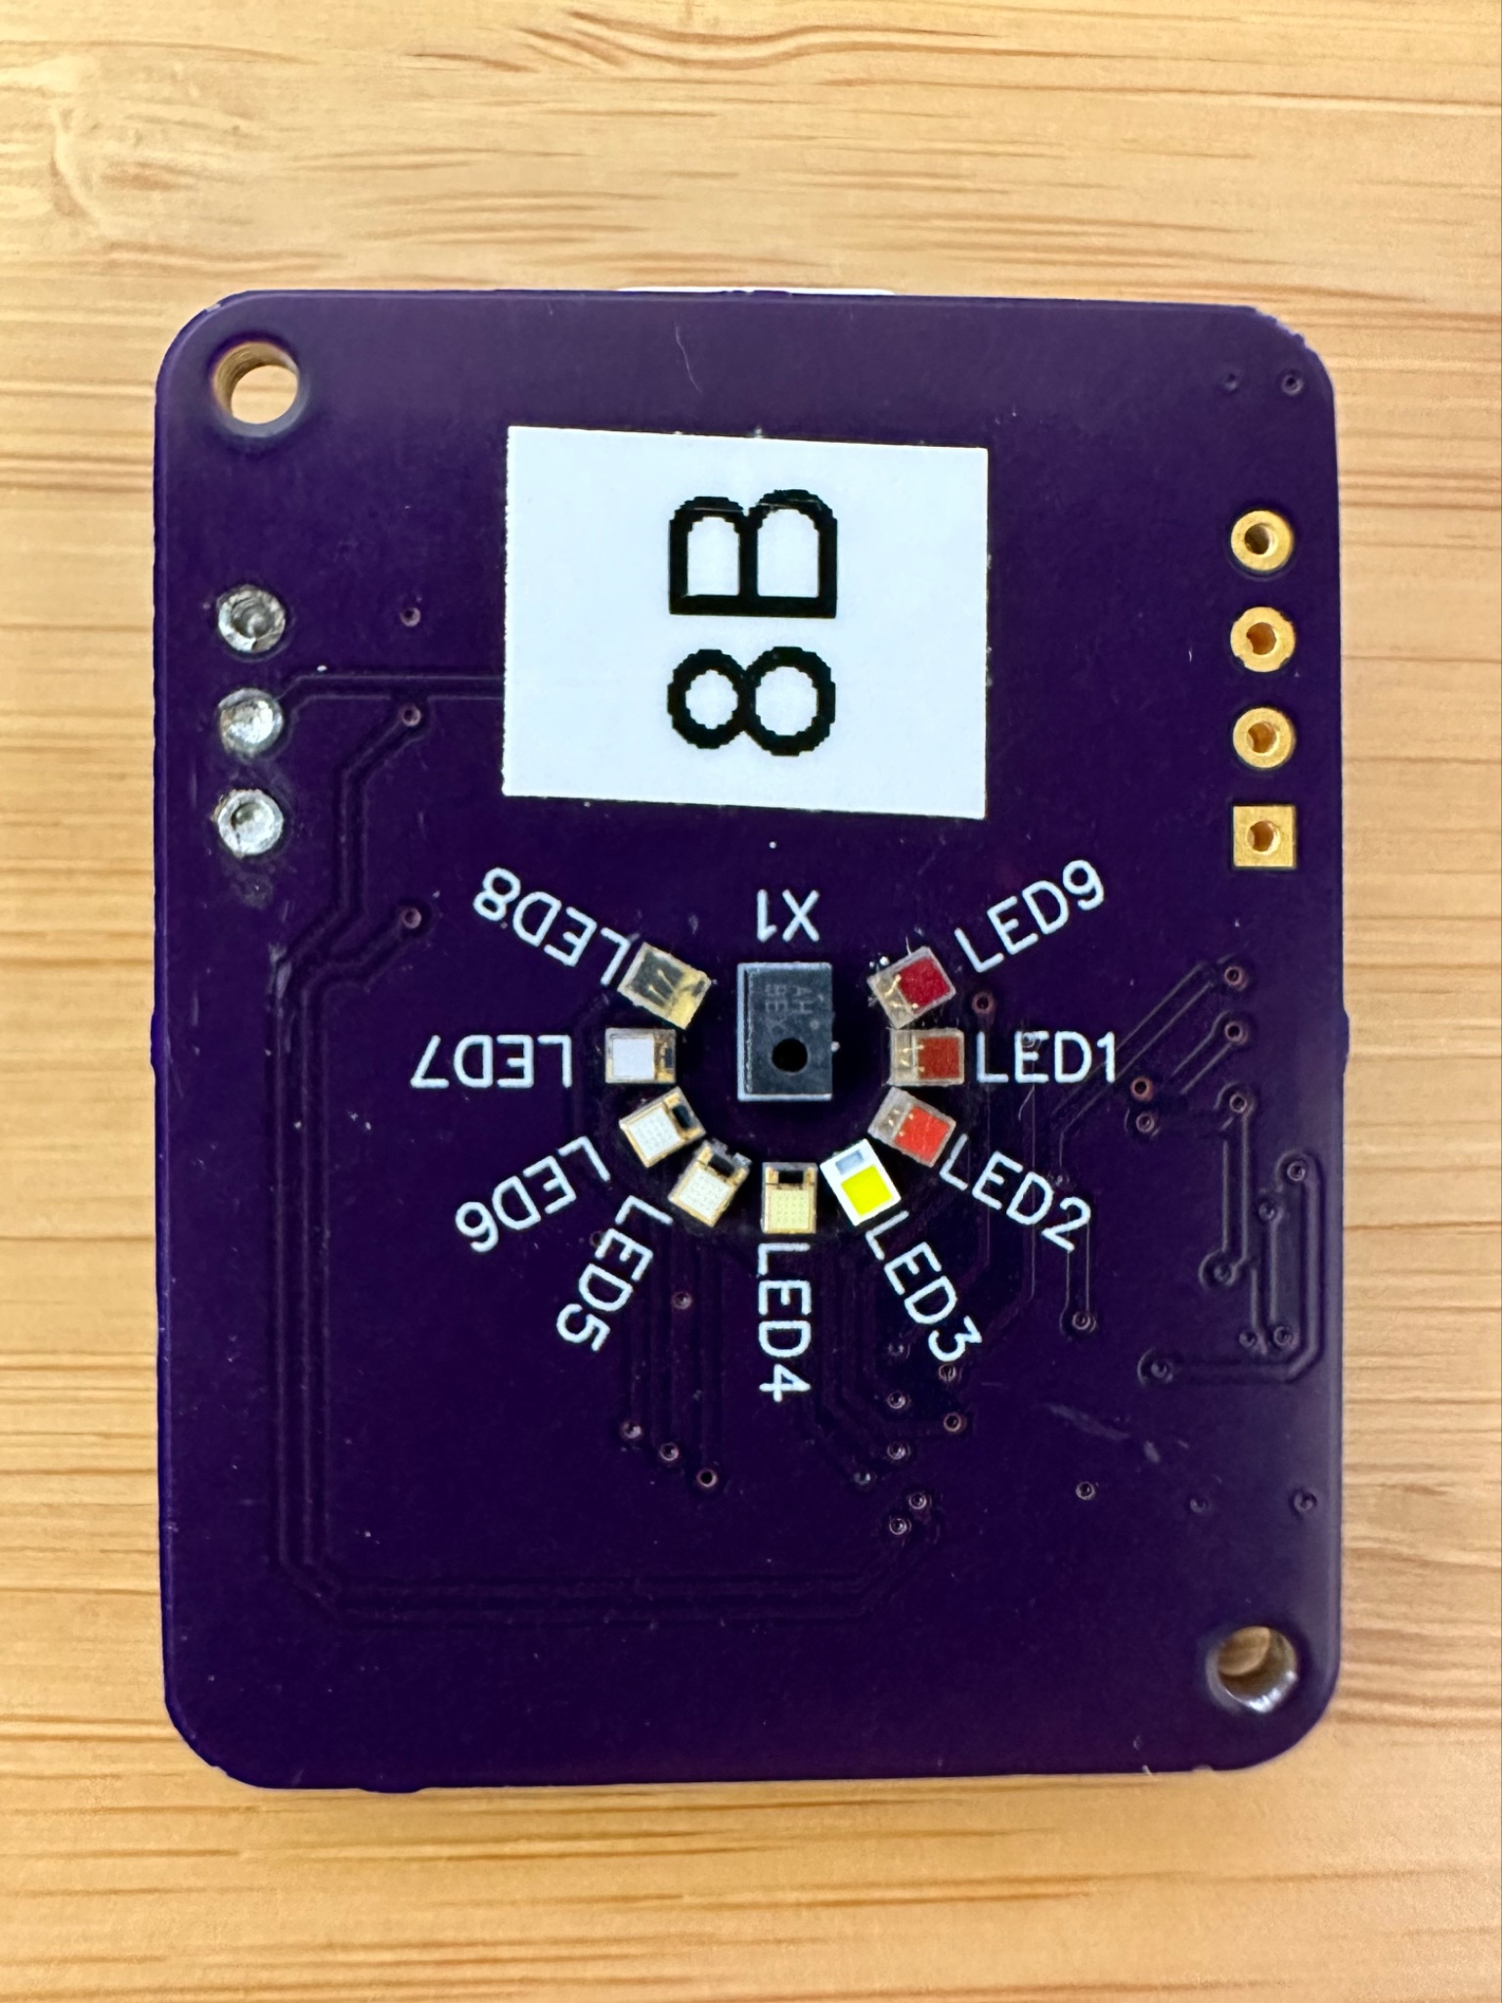
2.A Hardware design and build
Multi LEDs with Corresponding Photodiodes: Collect photoplethysmogram (PPG) data
Seeed XIAO nRF52: Process data and deploy TinyML to run trained detection model
Front
Seeed XIAO nRF52 microcontroller
LED driver
Back
LEDs and Photodiodes

Slide 5
2.B Dataset Source
This dataset was collected as part of a sleep study to examine the effects of restricted sleep on various physiological or behavioral parameters. The study involved seven subjects who were allowed only a 3-hour sleep period, simulating a short sleep duration scenario.
For analysis and model development, the dataset is split into two groups: five subjects are designated as the training set, serving as the primary basis for pattern recognition and predictive modeling, while the remaining two subjects form the test set, used to validate the performance of the trained models. This structured division ensures that the study results can be generalized and effectively evaluated.

Slide 6
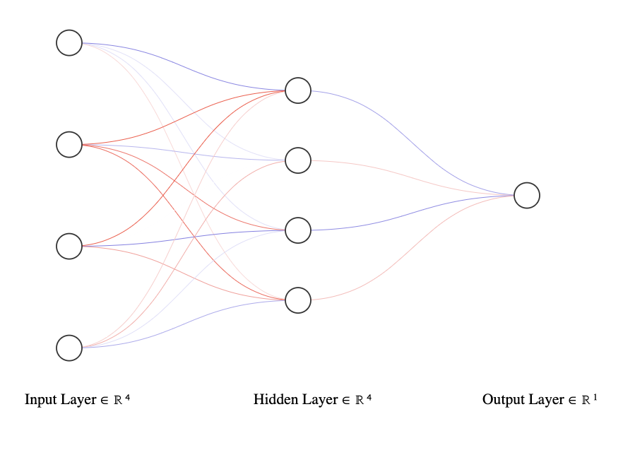
2.C Neural Network & Loss Function
We designed a simple feedforward neural network named Net to perform binary classification tasks. The architecture consists of:
Input Layer: The model accepts input with 4 features.
Hidden Layer: A fully connected layer (fc1) with 4 neurons, followed by a ReLU activation function to introduce non-linearity.
Output Layer: A single neuron (fc2) without activation, suitable for binary classification when combined with the BCEWithLogitsLoss function.
The absence of activation in the output layer allows the model to output raw logits, enabling seamless use with the Binary Cross-Entropy with Logits loss function.

Slide 7
3.A Model Performance Evaluation
The evaluation results demonstrate the progression of model training over 1000 epochs, showcasing significant improvements in both loss and accuracy. Starting with a loss of 0.5340 and an accuracy of 96.50% at epoch 100, the model achieves remarkable stability by epoch 1000, with a final loss of 0.0509 and accuracy consistently reaching 99.70%. This indicates effective learning and optimization throughout training. Upon completion, the model parameters and normalization details were saved, with conversion into C arrays for deployment in the file model_parameters.h.

Slide 8
3.B TinyML Implementation
Header Files
model_parameters.h: Contains model weights, biases, and normalization parameters for inference.
<math.h>: Provides mathematical functions, such as exp() for activation calculations.
Activation Functions
ReLU: Outputs x if positive, otherwise 0.
Sigmoid: Maps input to a range between 0 and 1, used for binary classification.
Prediction
The predict function computes output using the model and input data.
The final prediction is stored in the prediction variable for reporting.

Slide 9
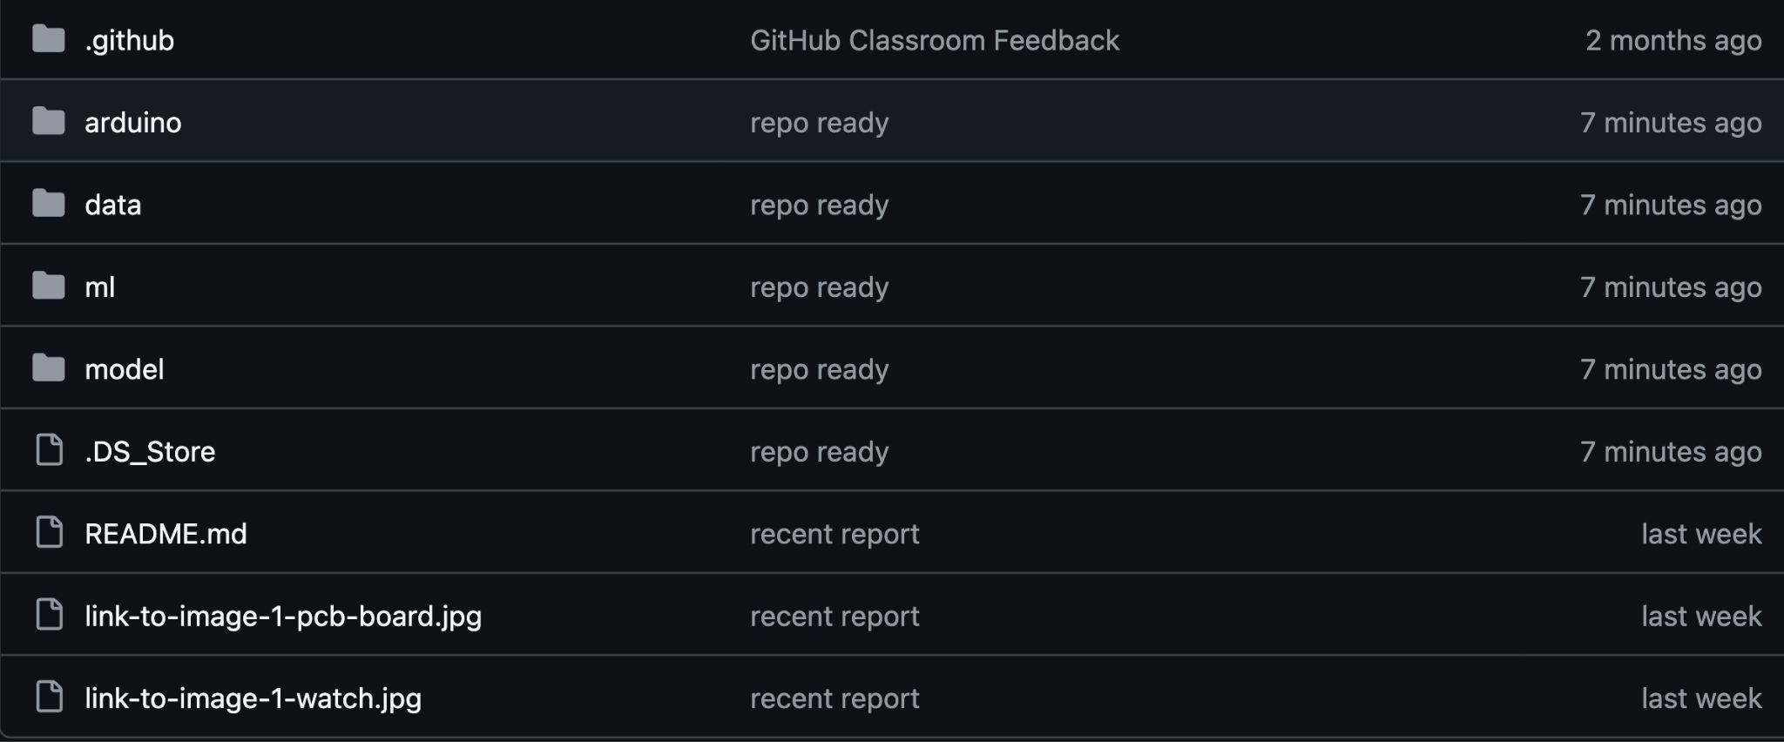
4. Github Repo
Arduino Code
Source Datasets
Machine Learning
Model Checkpoint

Slide 10
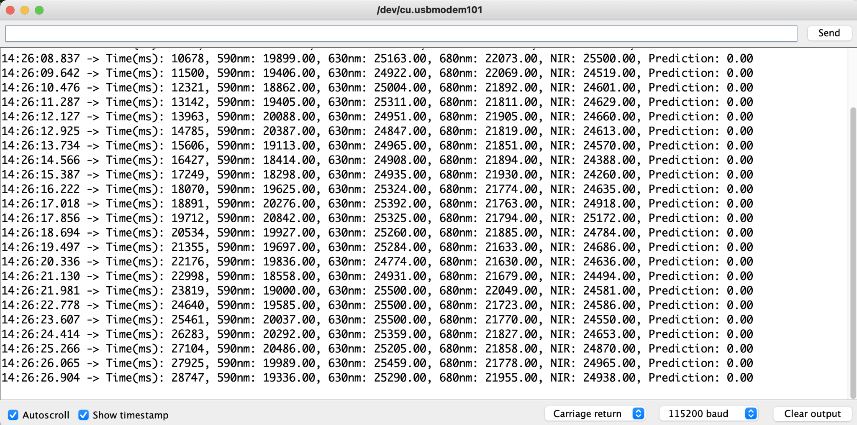
5. Demo

Slide 11
Thank you for listening

Slide 12
Team Name: Mien Sense
Haoran Zhang
Computer Engineering PhD
Target Area:
Machine Learning for Healthcare
Xi Chen
Electrical Engineering PhD
Target Area:
Healthcare Monitoring Sensor

Slide 13
Project Description: The goal of this project is to build a wearable device that incorporates TinyML to detect if someone is sleeping.

Slide 14
Project Description: The goal of this project is to build a wearable device that incorporates TinyML to detect if someone is sleeping. Key Objectives: - Deliver the device that's comfortable to wear - A communication system allowing wireless communication - Embed TinyML to predict the states

Slide 15
Project Description: The goal of this project is to build a wearable device that incorporates TinyML to detect if someone is sleeping. Key Objectives: - Deliver the device that's comfortable to wear - A communication system allowing wireless communication - Embed TinyML to predict the states Technology Stack: - Seeed XIAO nRF52840 sense - EasyEDA PCB Design - Python, C++ - Bambu 3D Printer

Slide 16
Hardware & Platform

Slide 17
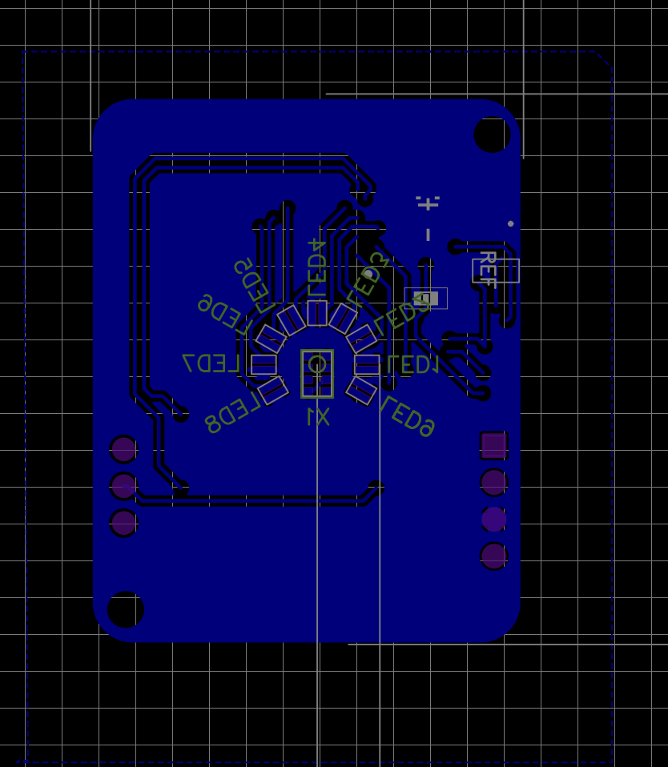
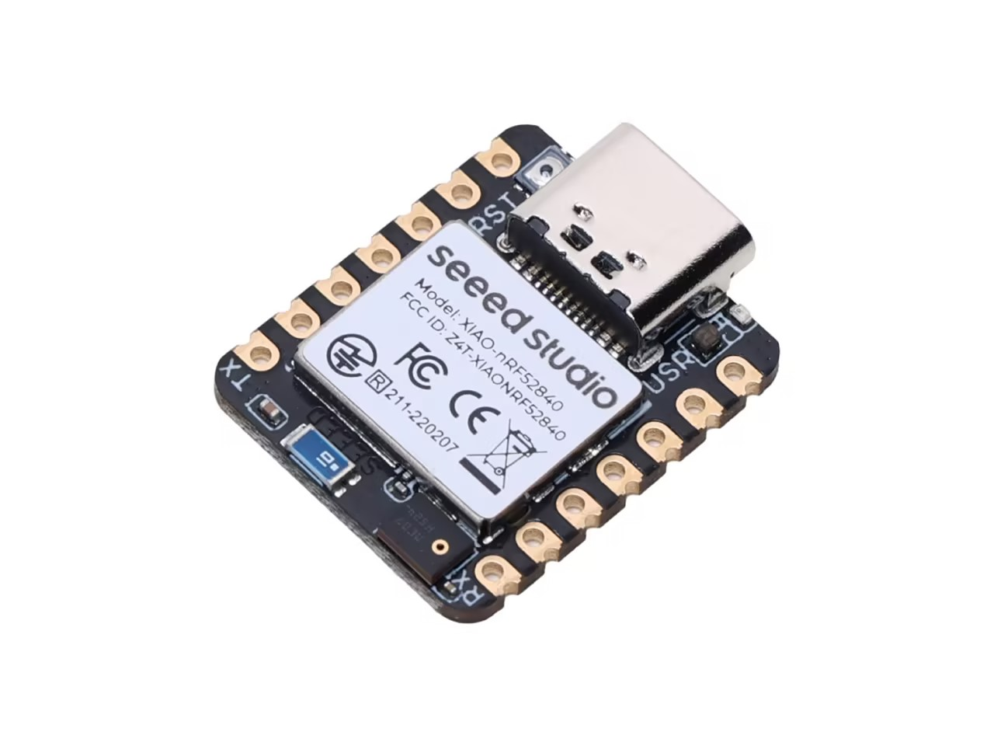
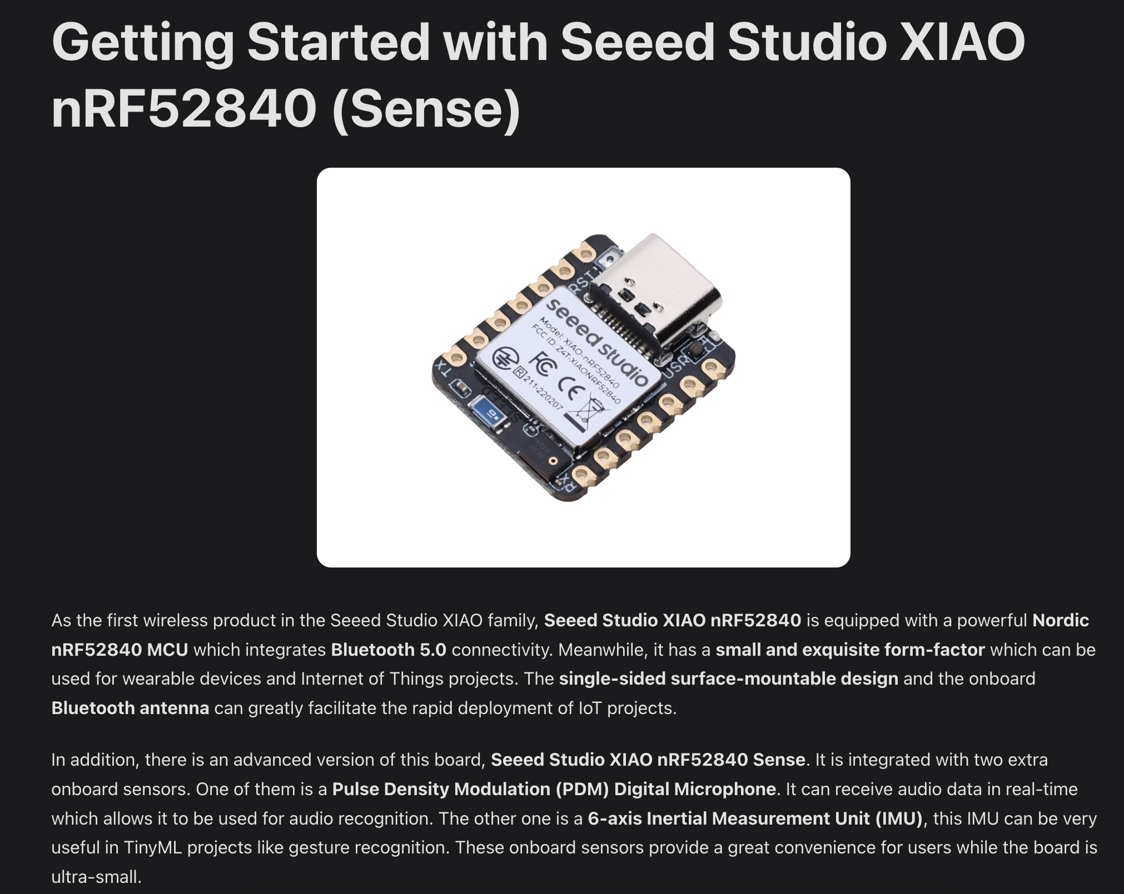
Arduino Board (tinyML embedded)
Seeed Studio XIAO nRF52840 (Sense): https://wiki.seeedstudio.com/XIAO_BLE/

Slide 18
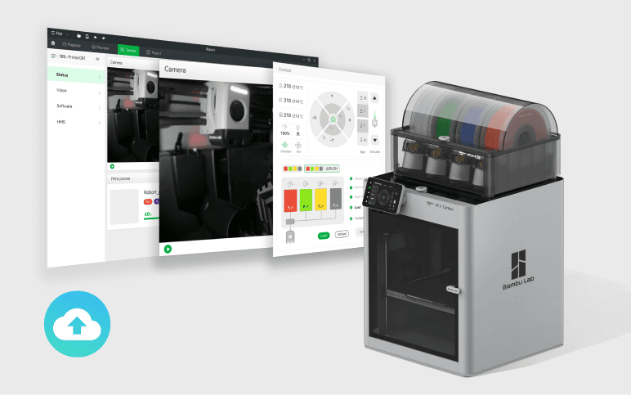
Print out prototype watch case

